Slide 1
Uniform Design
By : Disha Devani

Slide 2
Brain Storming
Lab Tech
Guest Services
Massage Therapist
Teacher
Uniform
Café Employee
Hair Dresser
Cabin Crew
Retail Sales Workers

Slide 3
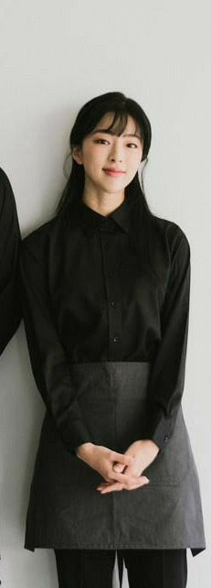
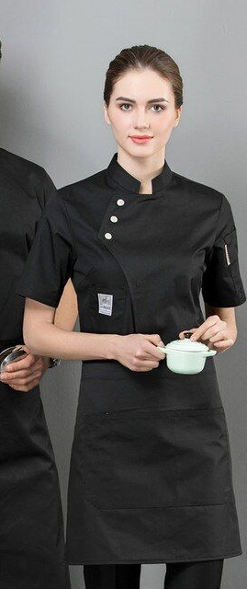
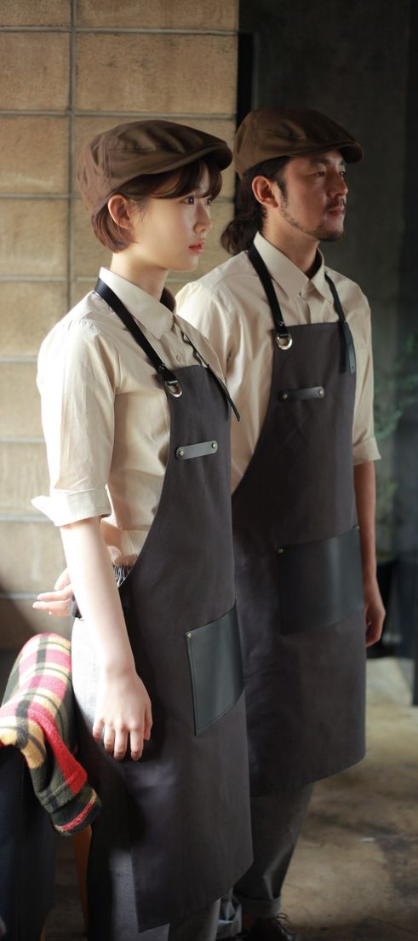
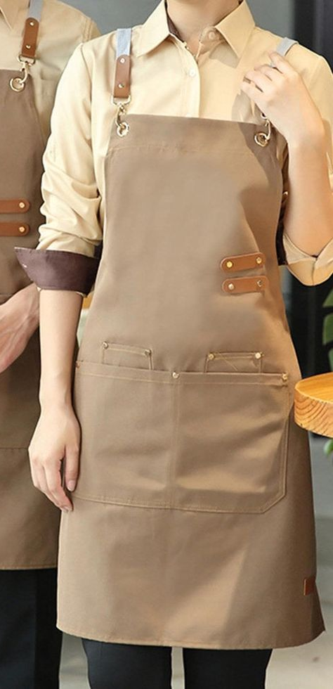
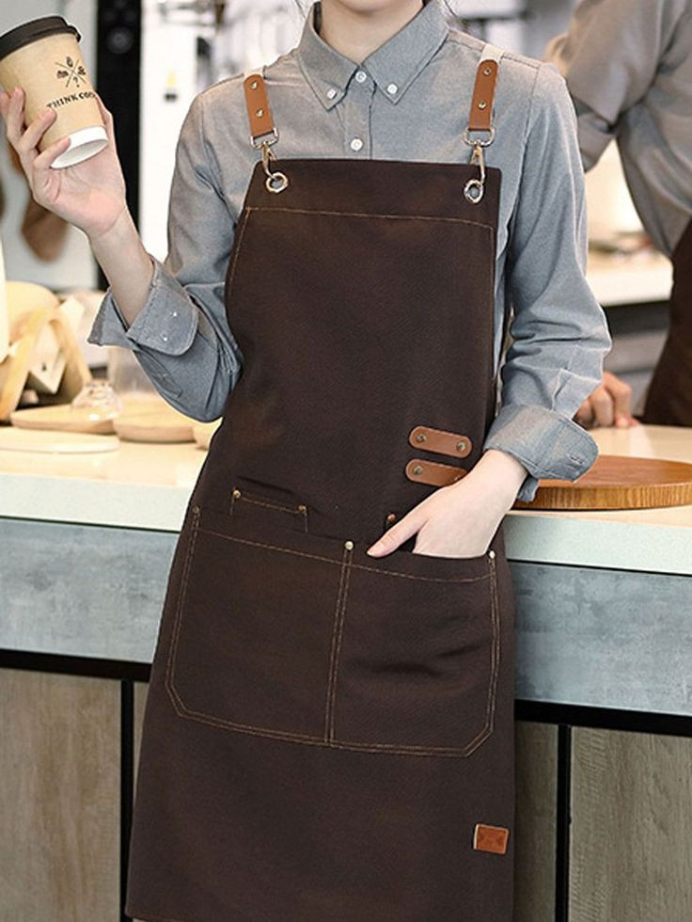
Trend Board

Slide 4
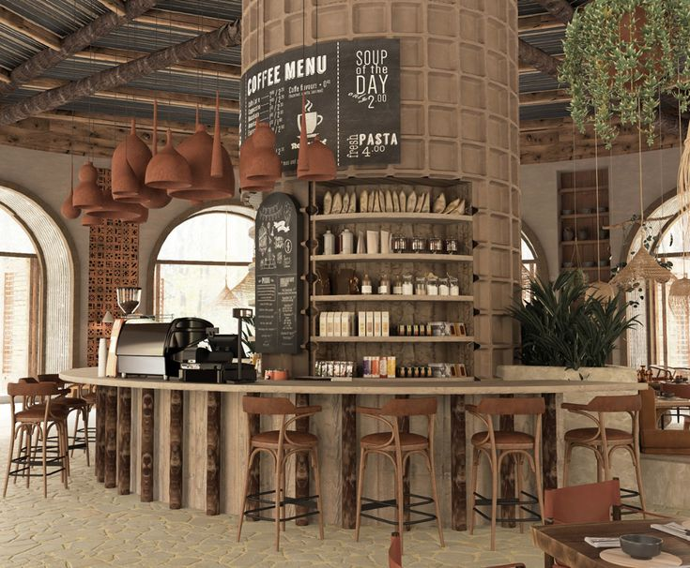
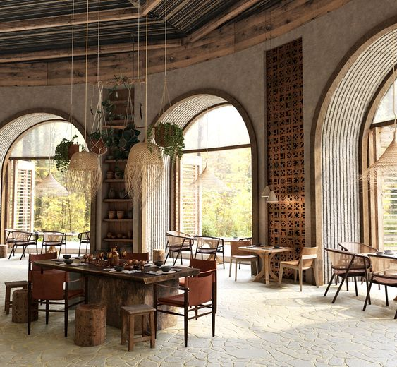
Inspiration

Slide 5
Research
Wabi-sabi is a traditional Japanese aesthetic philosophy centered on embracing imperfection, transience, and simplicity.
It is a worldview that appreciates beauty in things that are "imperfect, impermanent, and incomplete" in nature.
The term is a combination of two interrelated concepts: wabi, which can be translated as "subdued, austere beauty," and sabi, meaning "rustic patina“
Wabi-sabi is not just about aesthetics but also extends to sustainability and living in harmony with the environment. By valuing older items and choosing pieces that stand the test of time, wabi-sabi promotes sustainable design practices that reduce waste and emphasize longevity
wabi-sabi offers a unique perspective on beauty and life by celebrating the imperfect, transient nature of existence while emphasizing simplicity, natural beauty, and authenticity.

Slide 6
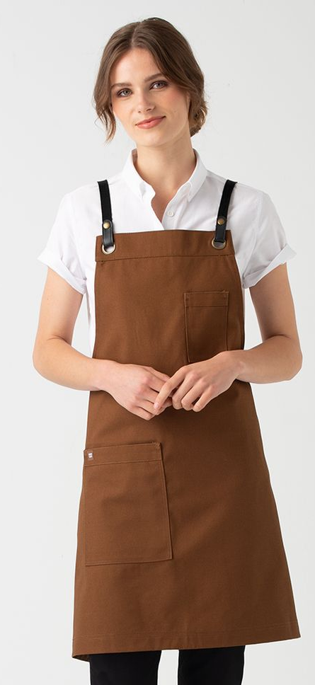
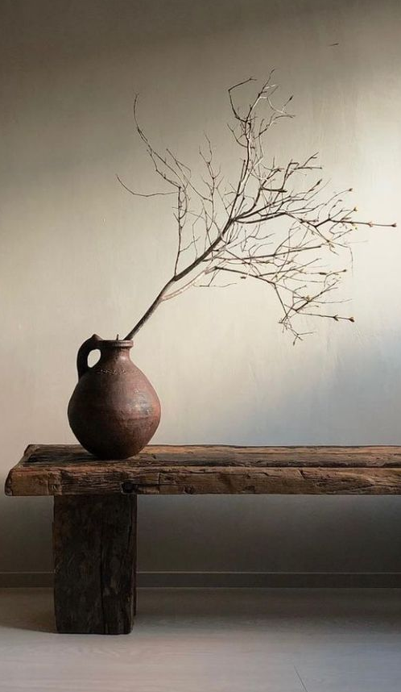
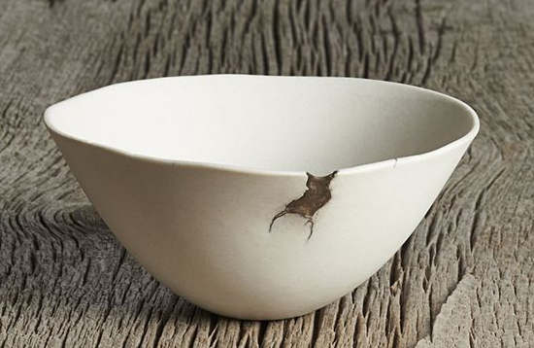
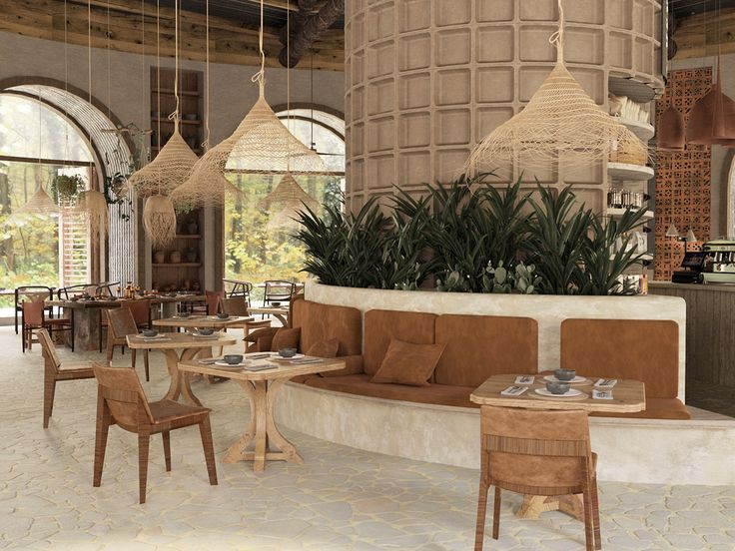
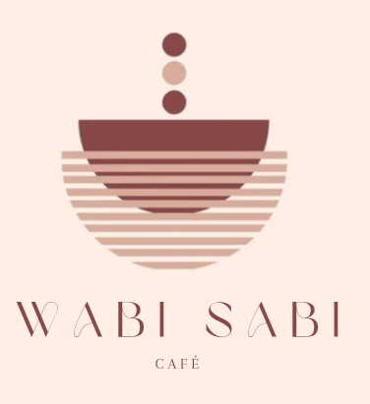
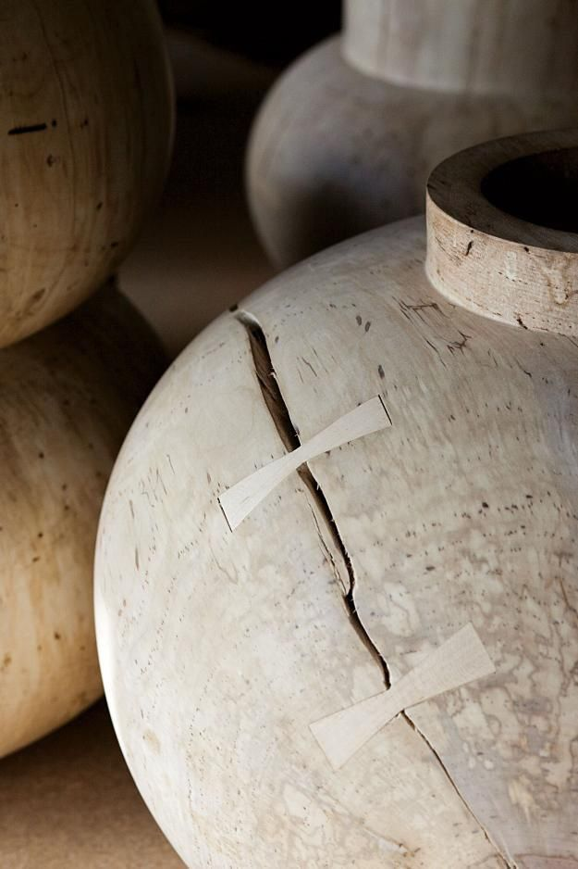
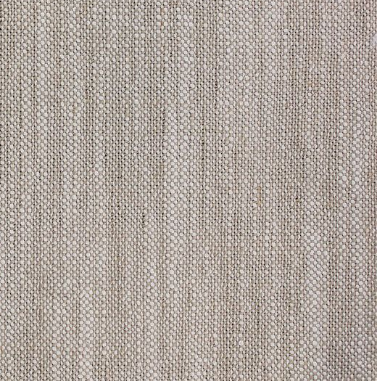

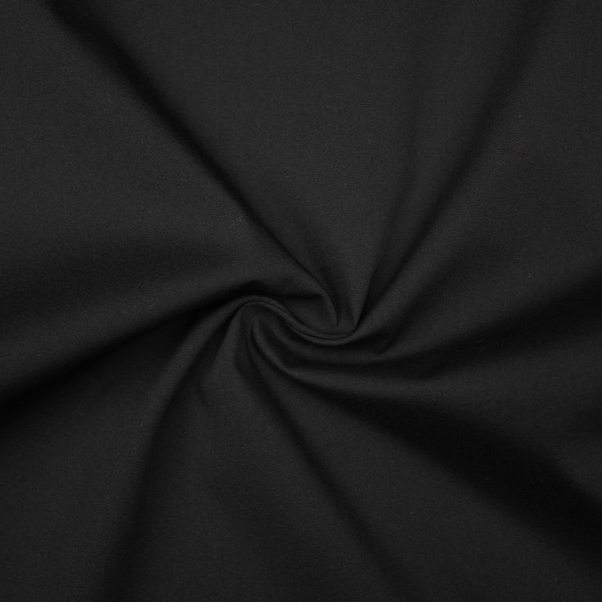
Imperfect Charm

Slide 7
Writeup
Imperfect charm is created for the café waitress of Wabi-Sabi Café. It is designed as the uniform of Café waitress. The age group for uniform is 19 to 30.
We’ve taken some inspiration form café interior and name. The colors are taken from coffee beans and milk and their familiar colors.
The fabric we’ve chosen is cotton satin and cotton by considering their role for work and comfort.

Slide 8
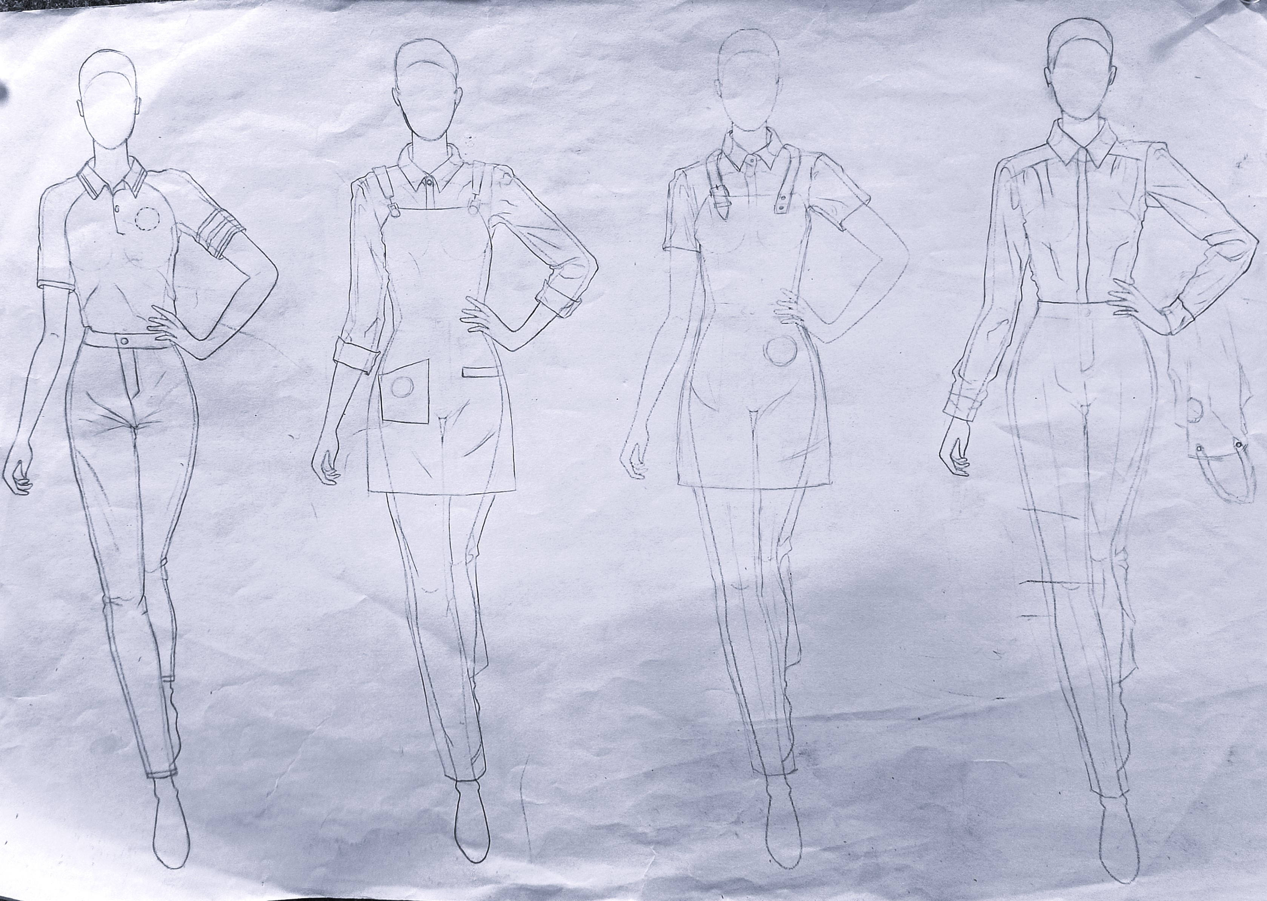
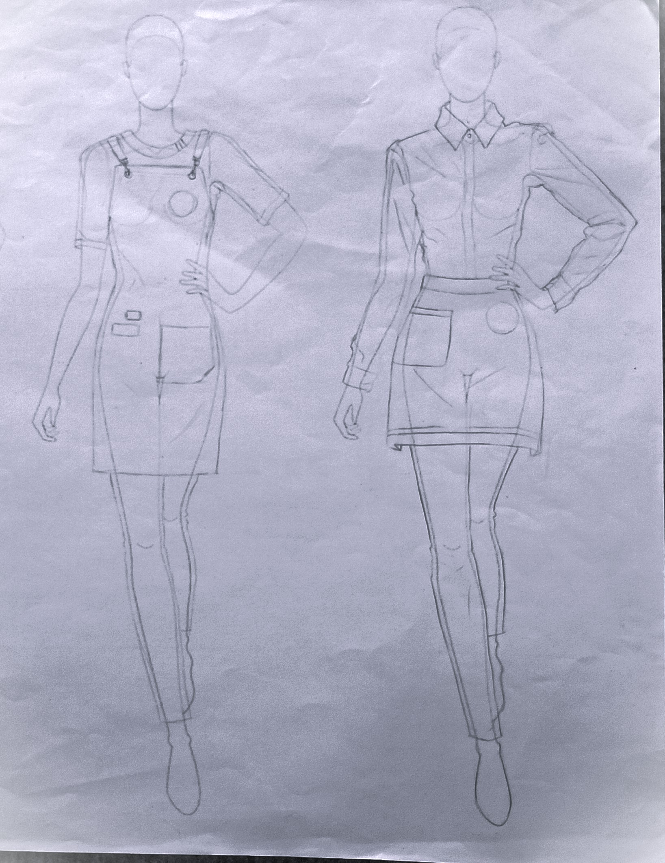
Ideation

Slide 9
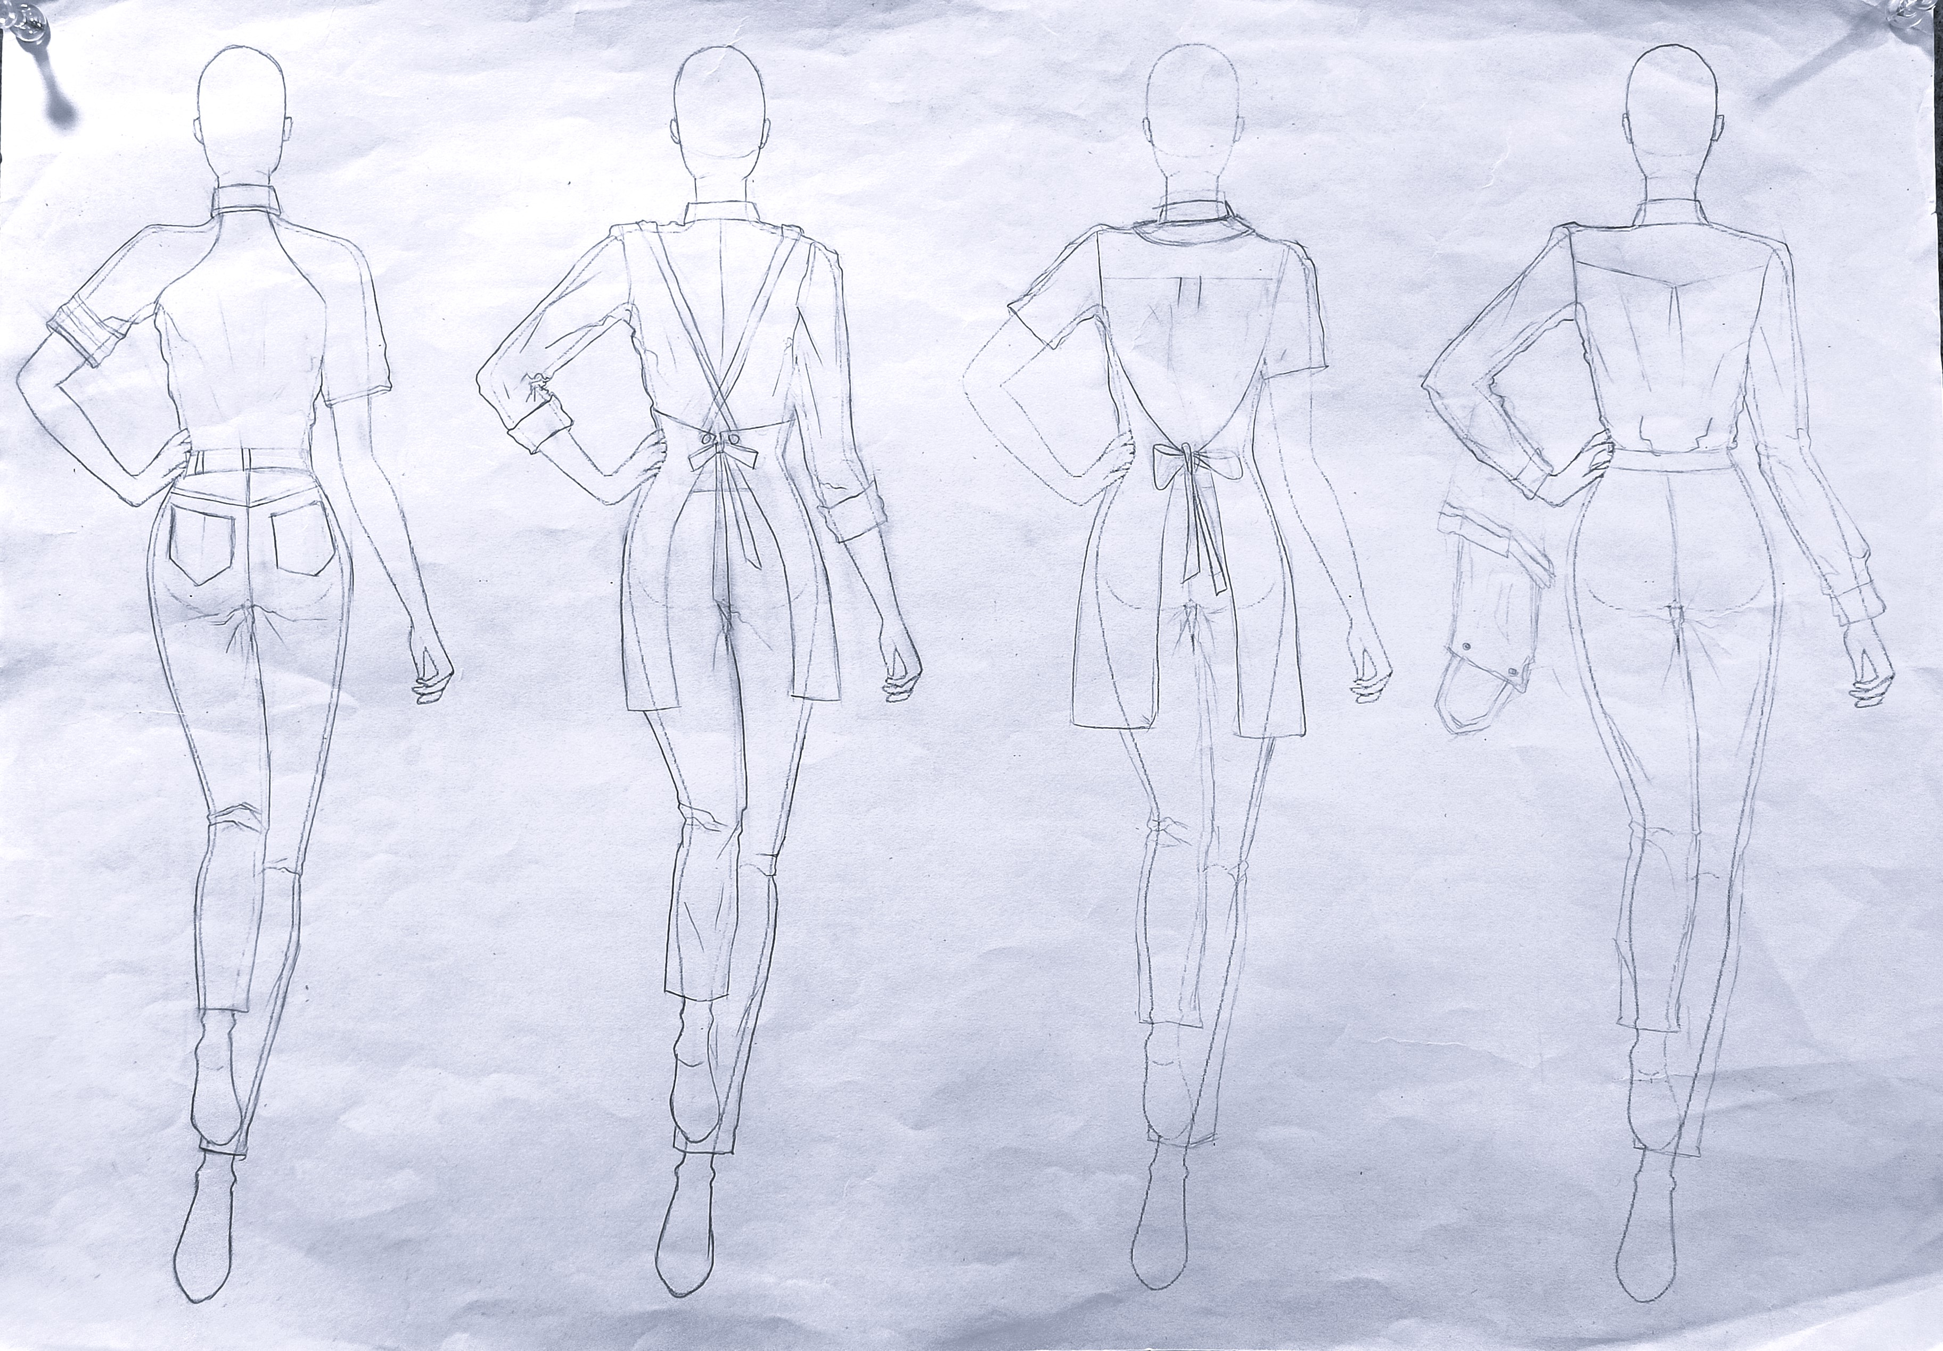
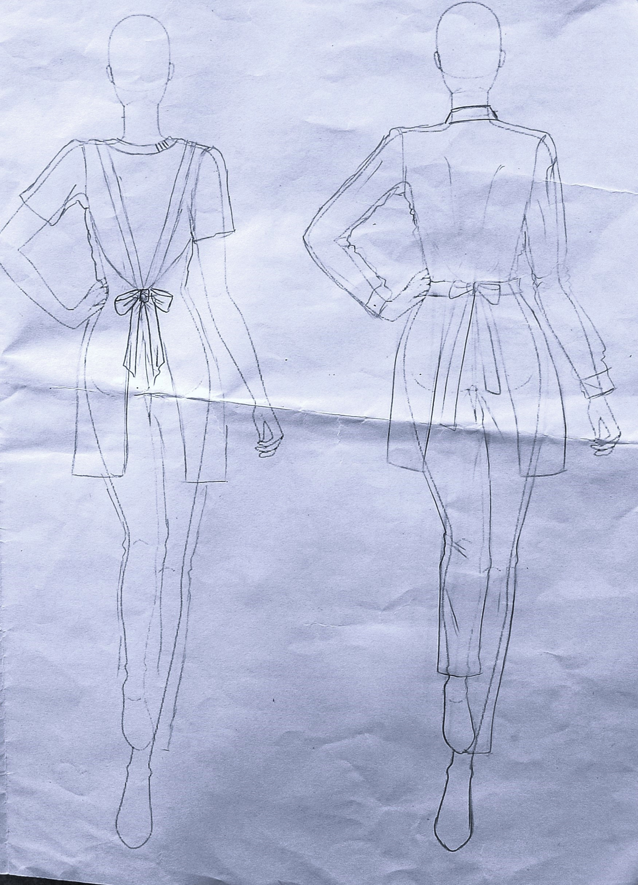
Ideation

Slide 10
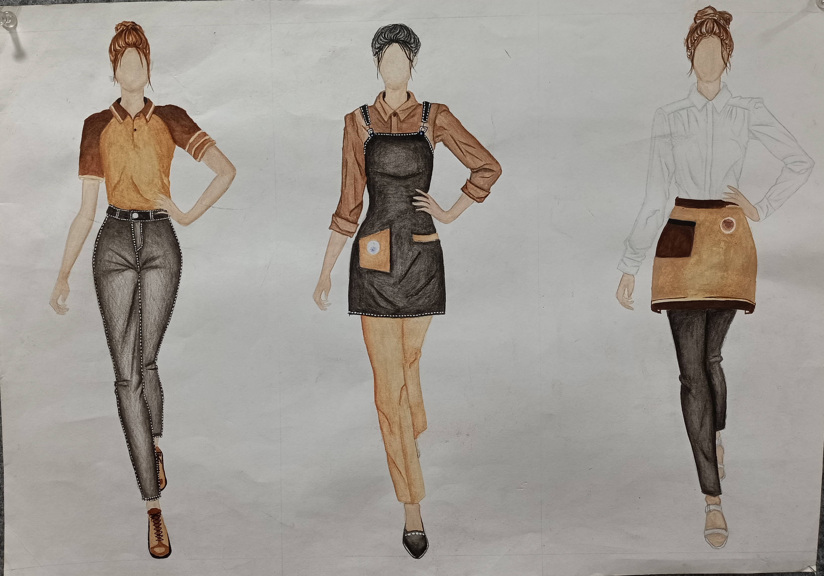
Finale Sketches

Slide 11
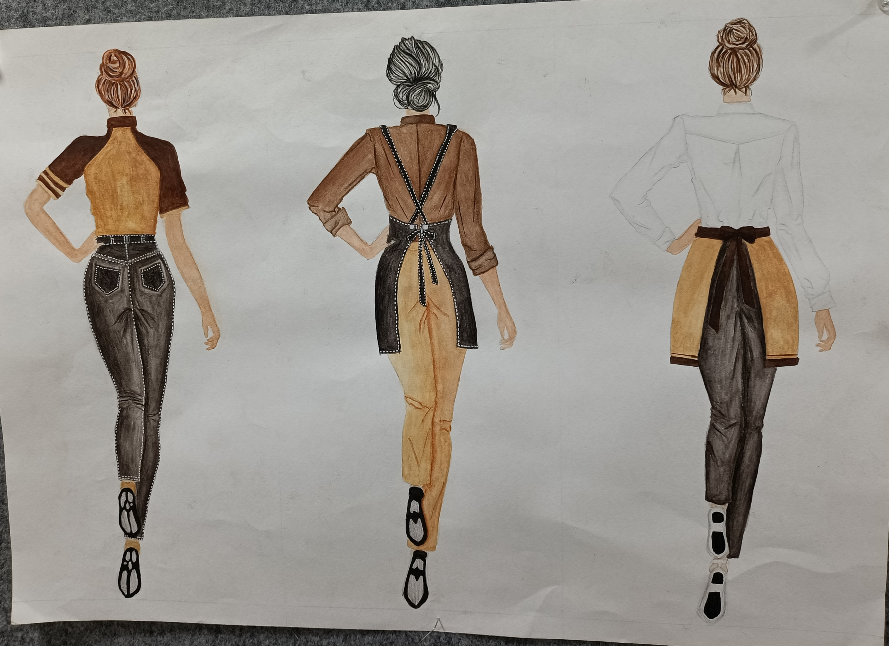
Finale Sketches

Slide 12
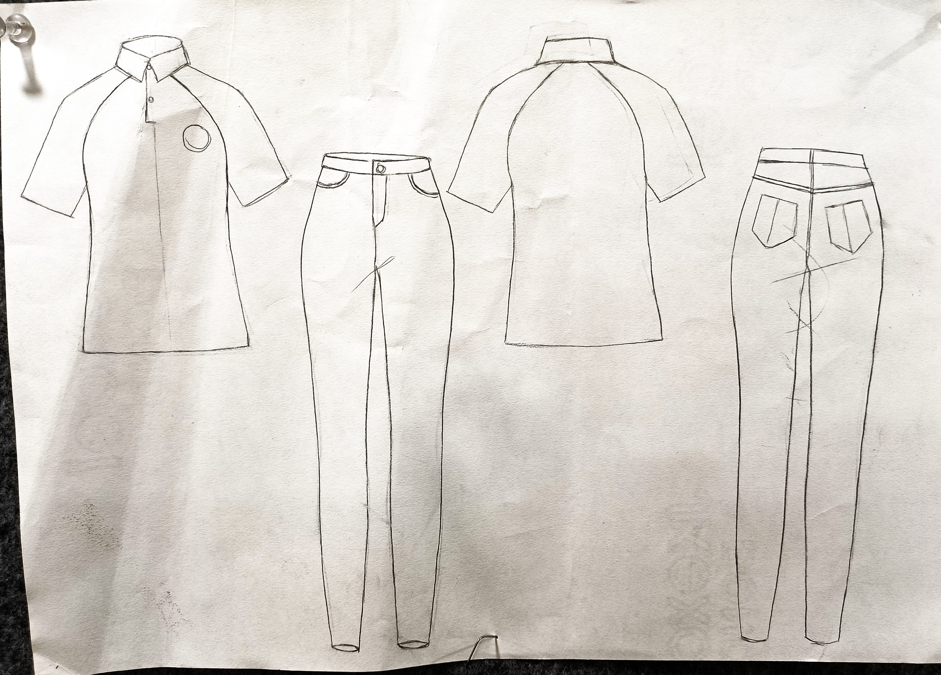
Flat Sketches

Slide 13
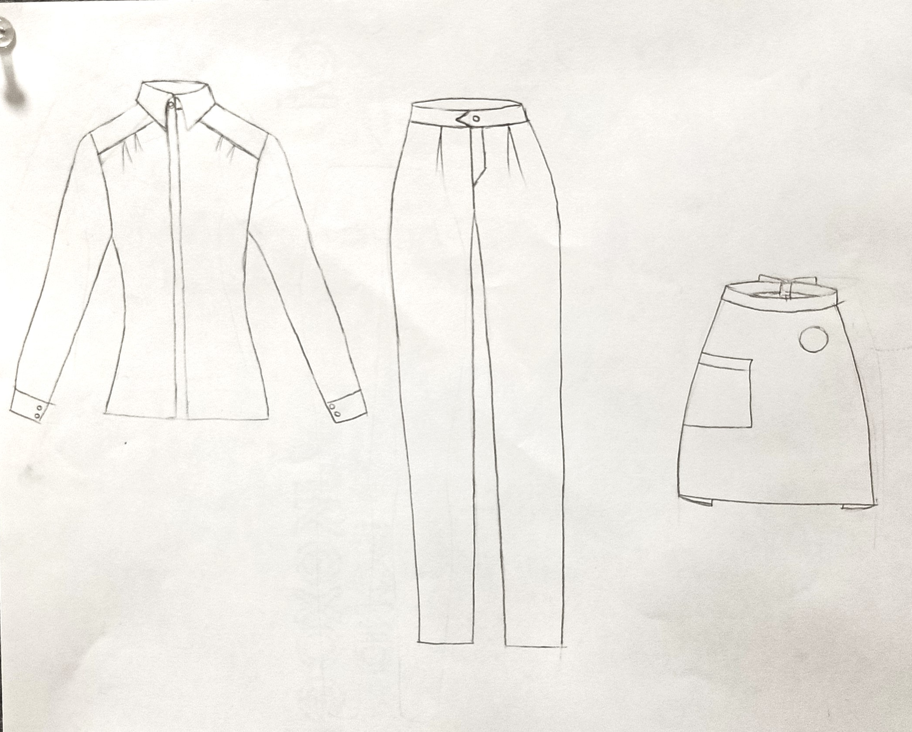
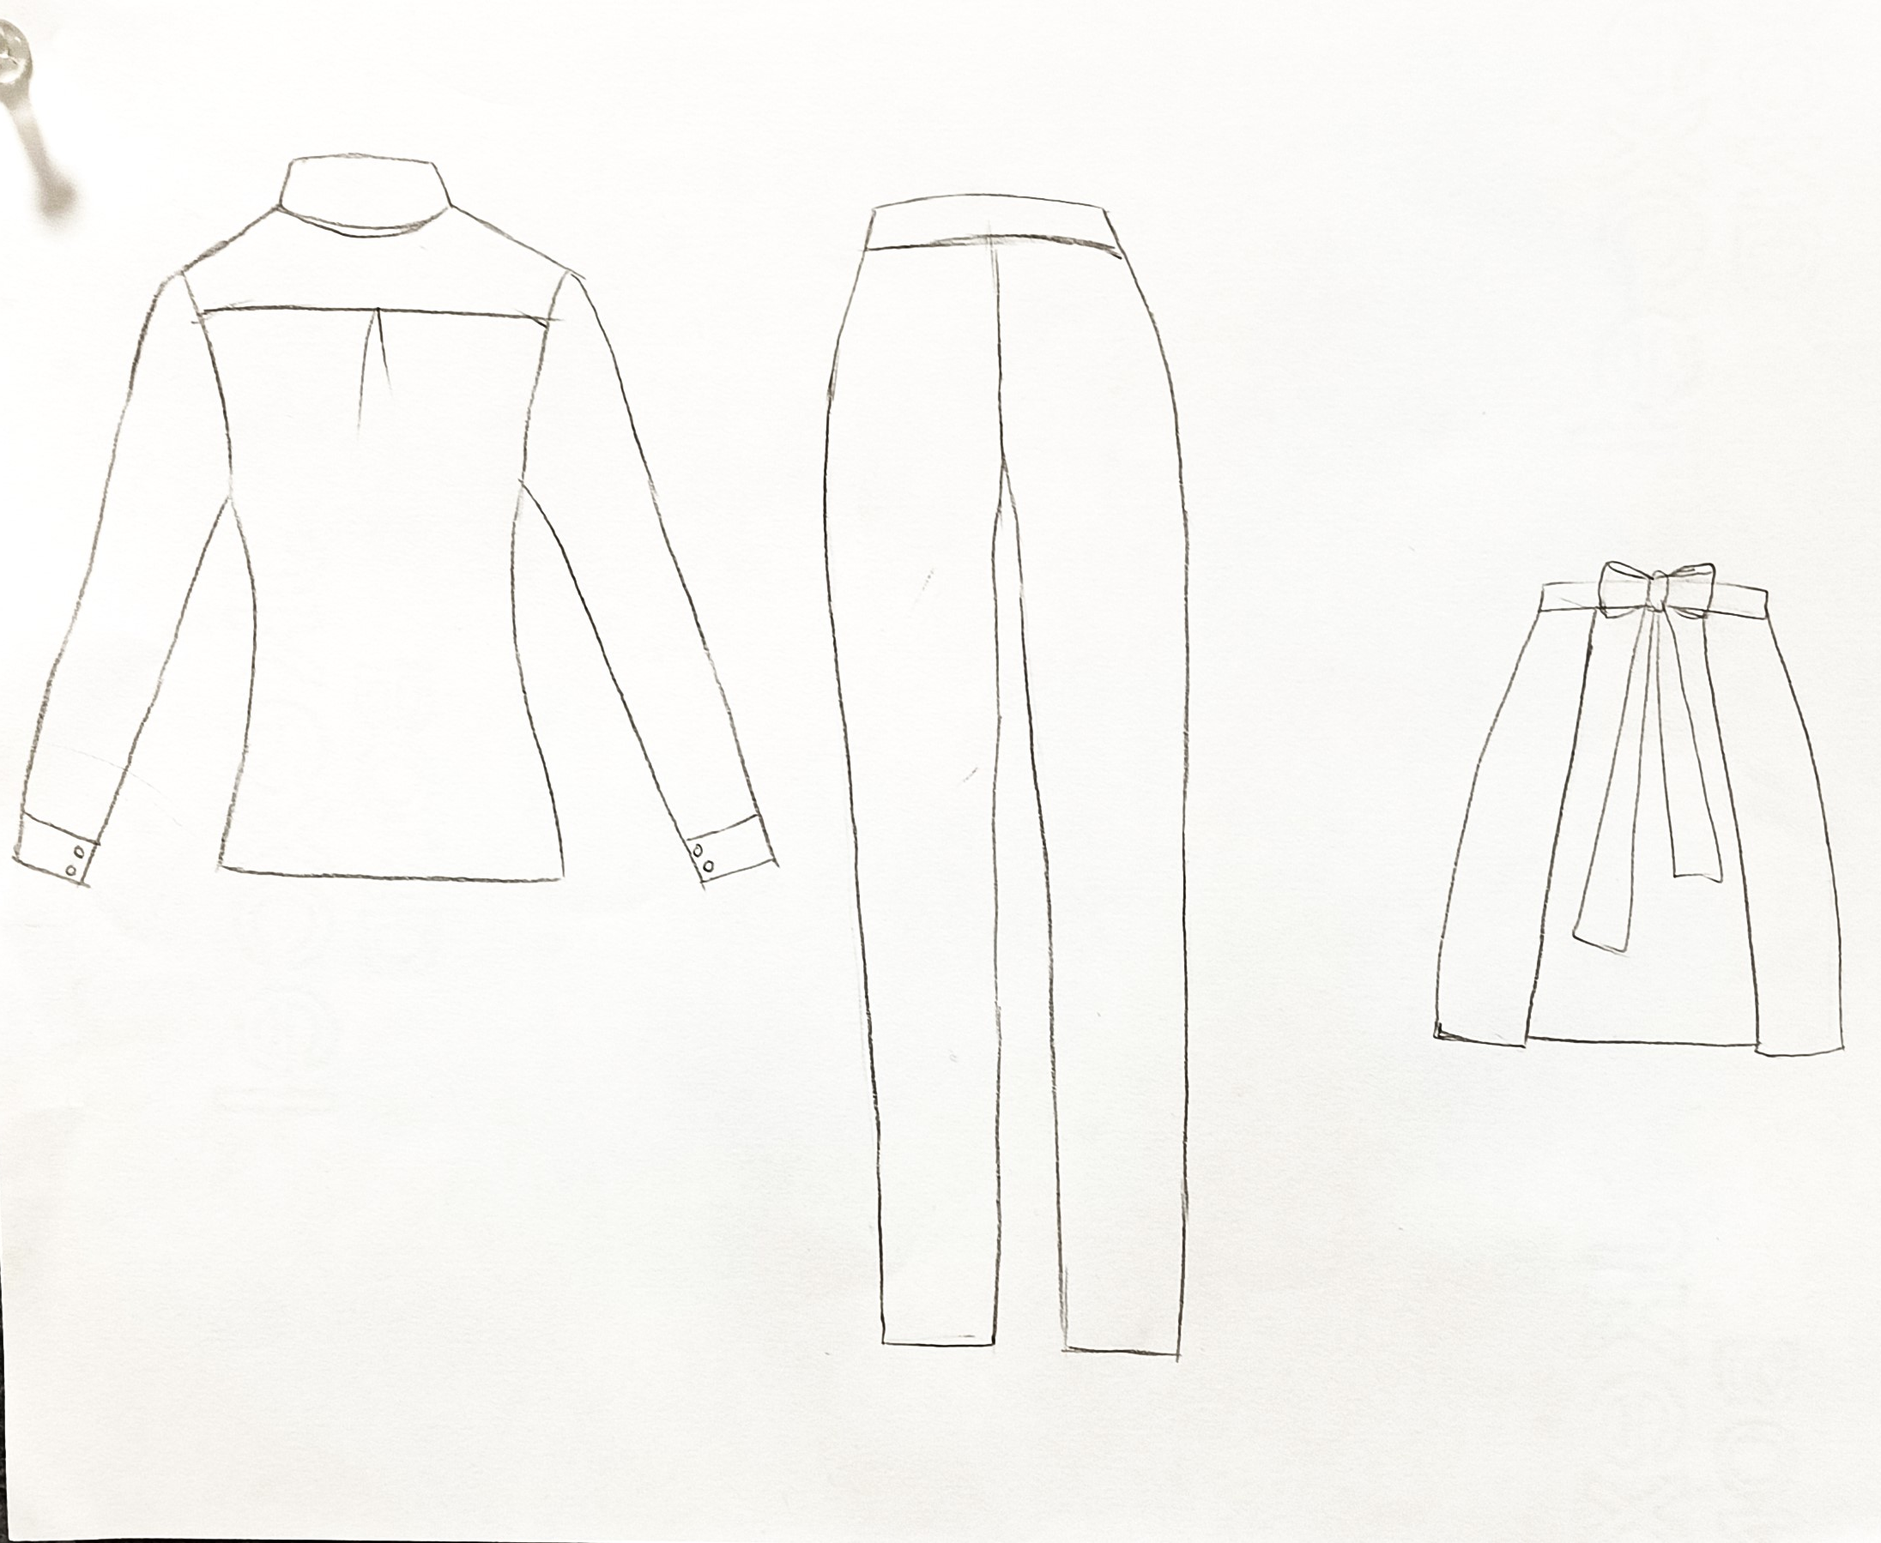
Flat Sketches

Slide 14
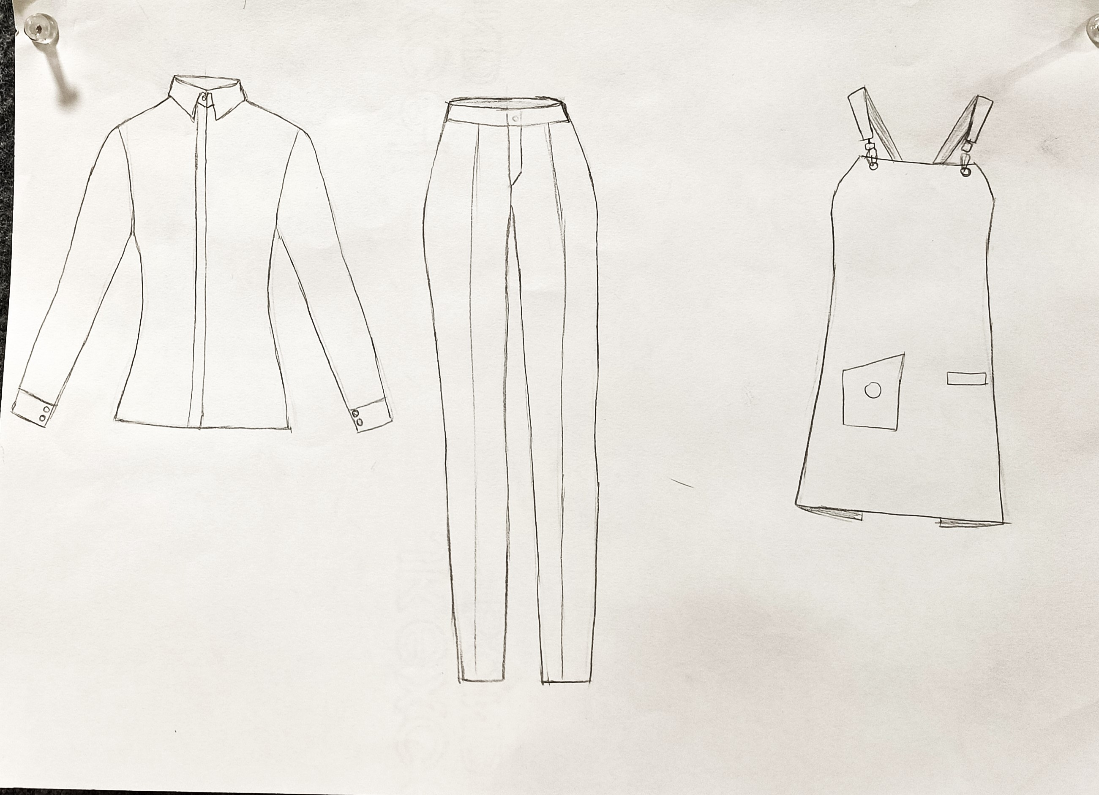
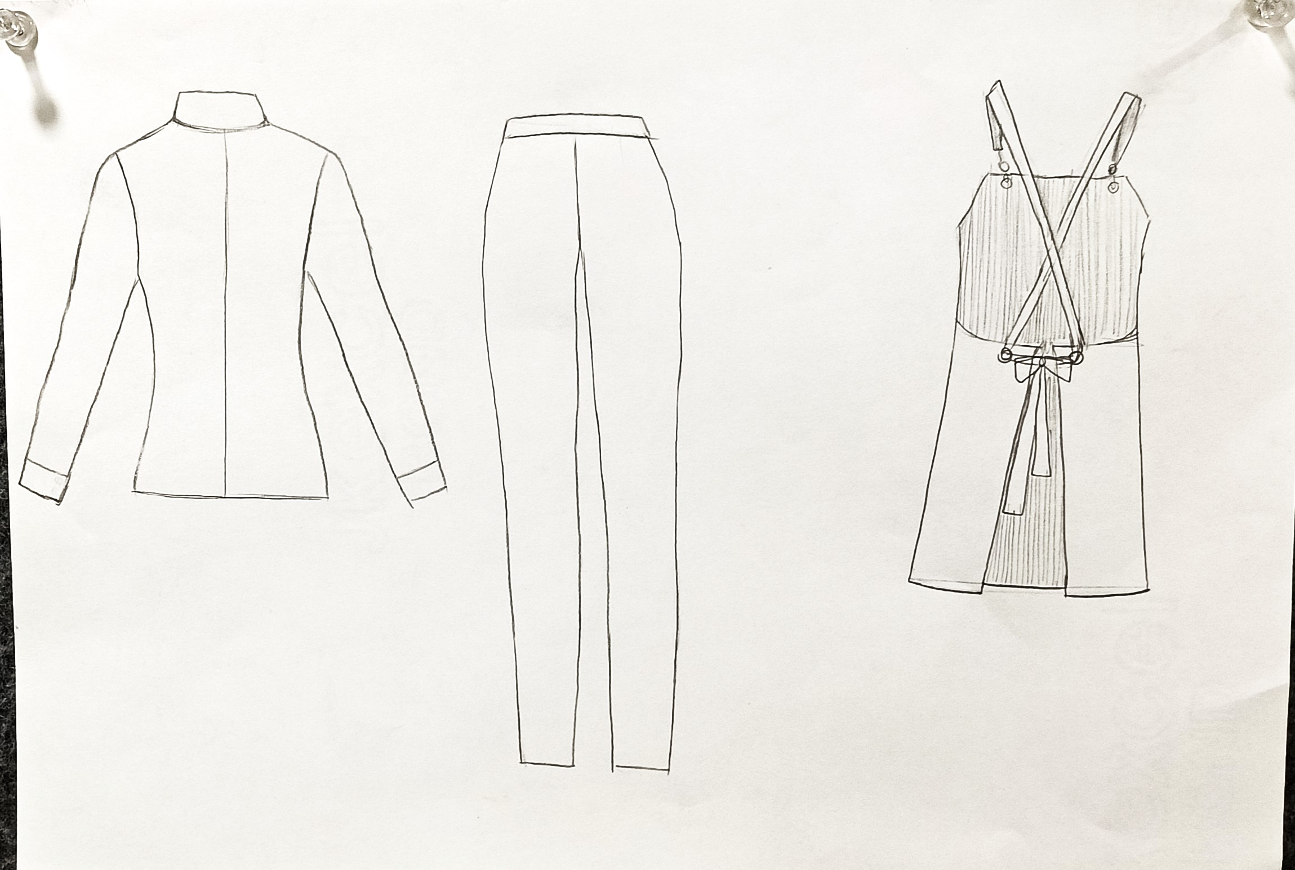
Flat Sketches

Slide 15
Thank You

